Slide 1
Q-DiT: Accurate Post-Training Quantization for Diffusion Transformers
（CVPR-2025) code：https://github.com/Juanerx/Q-DiT.
Reported by Jiale Shen

Slide 2
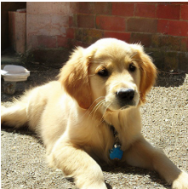
motivation
AI Model
1、automatic quantization granularity allocation to handle the significant variance of weights and activations across input channels
2、sample-wise dynamic activation quantization to adaptively capture activation changes across both timesteps and samples

Slide 3
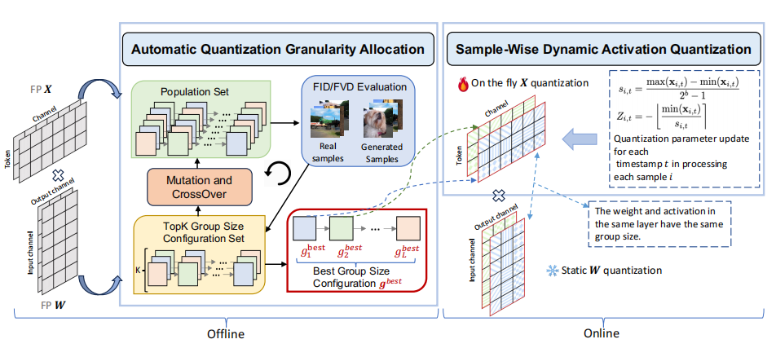
Overview

Slide 4
method1
W1 0.5
Group 16
W3 0.53
W4 0.49
……
method2
W1 0.25
Group 32
W3 0.43
W4 0.69
……
method3
W1 0.56
Group 8
W3 0.73
W4 0.89
……
......

Slide 5
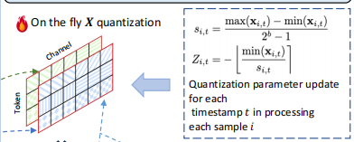
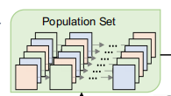
Approach

Slide 6
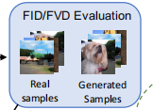
Approach

Slide 7
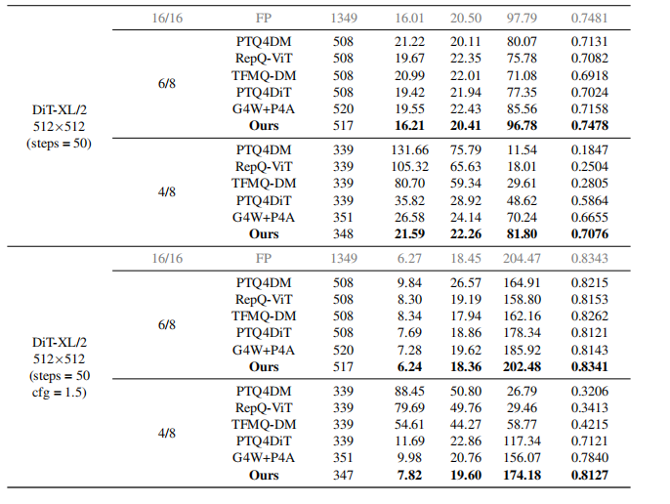
Experiment

Slide 8
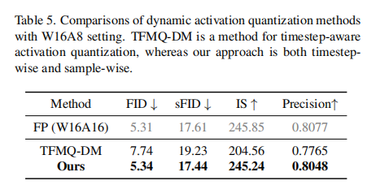
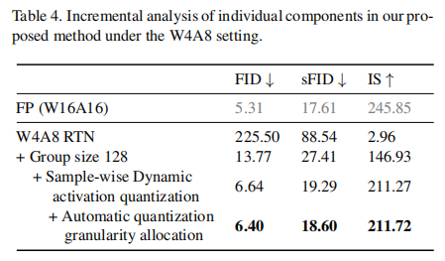
Experiment

Slide 9
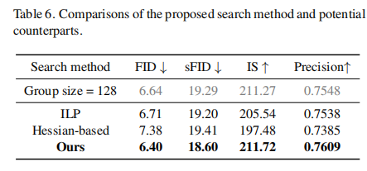
Experiment

Slide 10
Thank you!

